Slide 1
Guiding Principles for Creating Your Public Image
Original Slides: Nicole Immorlica, Microsoft
Presenter: Matt Weinberg, Princeton

Slide 2
Themes and Disclaimers.
Disclaimer: Most of the advice given in this talk is subjective: mix of advice from Nicole and Matt.
Nicole and Matt are both in CS Theory.
Recurring Theme: Always understand why.
Do look to others for examples of good talks/websites/papers/etc.
Don’t try to “follow the rules” without understanding why.
Will try to ask questions.

Slide 3
outline.
Several aspects contribute to your public image.
Papers you write.
Reviews you write.
Talks/Posters you present.
Your website.
In-person networking.
This is a non-exhaustive list. Overview guiding principles/sample advice for each.

Slide 4
Writing Principles
Main goals:
Engage/entertain the reader.
Convince them your work is awesome (and correct).
Everything else is secondary.
I really mean this! View everything through this lens.
No “formatting requirements” (although norms exist).
Next several slides break down how Nicole/I normally try to convince the reader our work is awesome.
But these are not hard/fast rules. Ask why!

Slide 5
outline.
Title: phrase indicating what you did
Abstract: concise description of what you did
Introduction: motivate and informally define problem, emphasize intuition and key contributions
Related Work: how your work fits with the literature
Model: the mathematical setting you consider
Results: statement, important/interesting proofs
body
Appendix: remaining proofs, minor extensions

Slide 6
title.
Purpose: Briefly indicate why someone might be interested in reading your paper.
Example: Is it OK to be catchy/funny?
Sure! If it is also descriptive.
Of the People: Voting is more Effective with Representative Candidates, Cheng, Dughmi, and Kempe, EC 2017.
Prophet Inequalities made Easy: Stochastic Optimization by Pricing non-Stochastic Inputs, Dutting, Feldman, Kesselheim, Lucier, FOCS 2017.

Slide 7
title.
Good
Bad
Descriptive (but brief)
Vague

Slide 8
title.
Bad:
Information Aggregation in Social Networks, Feldman, Immorlica, Lucier and Weinberg, 2014, working paper.
Good:
Reaching Consensus via non-Bayesian Asynchronous Learning in Social Networks, Feldman, Immorlica, Lucier and Weinberg, APPROX 2014.

Slide 9
title.
Purpose: Briefly indicate why someone might be interested in reading your paper.
Example: Why is vague bad?
Information Aggregation in Social Networks.
Is it a theory paper? Empirical study?
No idea what makes it different from the 100,000 other papers on information aggregation in social networks.

Slide 10
abstract.
Purpose: Help someone understand what’s in the paper (normally targeted at an expert), and whether they should read more.
Example: Should I sell the main results?
You could state objectively why the main result is interesting, so an expert knows what’s the point.
You shouldn’t go overboard, you have an entire introduction for that.
E.g. “This is the first constant-factor approximation.”

Slide 11
abstract.
Good
Bad
concise
fact-based
accurate
identifies keywords
wordy
salesmanship
over-claiming
inaccurate terminology
Pet Peeve: abstracts that are really introductions.

Slide 12
abstract (bad).
In a social learning setting, members of a society share their experiences to help others make better choices.
Following the established path can boost an individual’s utility but it can hurt the society as a whole since
other options of higher value may never be explored. We show that when the population is diverse, this
issue can be avoided as people may not be satisfied with the available choices and look for alternatives. High diversity, though, comes at a cost as past experiences become less valuable.

Slide 13
abstract (bad).
We model these situations in a standard setting of consumer search introduced by Weitzman and study how different diversity levels compare with each other. We … and quantify how the socially optimal diversity level changes …. Moreover, while high diversity can lead to anarchy and confusion in typical situations, we show that it can be really beneficial in settings where society may accidentally uncover a unanimously accepted hidden gem.

Slide 14
abstract (good).
We introduce a general model of bandit problems in which the expected payout of an arm is an increasing concave function of the time since it was last played. We first develop a PTAS for the underlying optimization problem of determining a reward-maximizing sequence of arm pulls. We then show how to use this PTAS in a learning setting to obtain sublinear regret.

Slide 15
introduction.
Purpose: Serves a few purposes, tricky to balance.
Get the reader excited to read the rest of the paper.
Tell a skimmer what’s cool about the paper.
In both cases, focus on why it’s cool.
Example: Should I sell the main results?
Absolutely! Don’t be afraid to tell the reader exactly why it’s cool.
(From a selfish perspective: don’t be afraid to tell the reviewer exactly what they should state as the “main contributions” in their review).

Slide 16
introduction.
Good
Bad
motivation from practice or existing literature
place results in context
identify take-aways and key intuition
flimsy stories or cartoon realities
abstracts of related work
overly-precise statement of results and techniques
Pet Peeve: Laundry lists of results with no motivation.

Slide 17
introduction.
Purpose: Serves a few purposes, tricky to balance.
Get the reader excited to read the rest of the paper.
Tell a skimmer what’s cool about the paper.
In both cases, focus on why it’s cool.
Example: Should I overview techniques?
Only do so to emphasize a why.
Ex: “We first use a reduction of XYZ, then Chernoff bounds, then some calculus” contributes nothing.
“The key to our approach is the recent reduction of XYZ, developed for an unrelated problem.”

Slide 18
introduction.
Purpose: Serves a few purposes, tricky to balance.
Get the reader excited to read the rest of the paper.
Tell a skimmer what’s cool about the paper.
In both cases, focus on why it’s cool.
Example: Should I overview techniques?
Most theory papers choose to do this. Not required.
Helpful if there is something exciting/digestible/etc.
Really not helpful if the reviewer can’t understand it.
Always ask: what would a reader get from this?

Slide 19
Related work.
Purpose: Provide context for your work.
Most related stuff (ideally) already covered in intro.
Also to assign scientific credit for prior work.

Slide 20
related work.
Good
Bad
comprehensive
describes connections
cites work from multiple fields
skimpy
reads like a list
unaware of related literature
Pet Peeve: sections that read like a list of abstracts!
Notes:
Note: this is often how your reviewers get picked, so cite the people you want reviewing your paper.

Slide 21
Related work.
Purpose: Provide context for your work.
Most related stuff (ideally) already covered in intro.
Also to assign scientific credit for prior work.
Example: How much detail should I give?
Enough to make your point!
Ex: “Cai and Daskalakis give a PTAS for a single unit-demand buyer with independent MHR item values, to the optimal deterministic item pricing.”
Useful if you give a PTAS for a related problem.
Not useful just because you study pricing.

Slide 22
Related work.
Purpose: Provide context for your work.
Most related stuff (ideally) already covered in intro.
Also to assign scientific credit for prior work.
Example: How much detail should I give?
Enough to make your point!
Ex: “Works such as [CaiD11, …] also provide approximations in different models to ours.”
Useful if you study unrelated pricing problem.
Not enough if reviewer might reasonably wonder what your work contributes over CaiD11.

Slide 23
Model.
Purpose: Start being formal.
Most intuition (ideally) already given in intro.
Need to be precise, but also clear.

Slide 24
model.
Good
Bad
notation consistent with existing norms
covers limited prelim results/background
rigorous, yet clear
overloaded or excessive notation
contains major theorem statements and proofs
overly formal, or imprecise
Notes:
Like don’t index the integers with x!

Slide 25
Model.
Purpose: Start being formal.
Most intuition (ideally) already given in intro.
Need to be precise, but also clear.
Example: Should I give an example?
Sure! If it serves a purpose.
If complicated definitions, to illustrate definitions.
If simple, no point.
To illustrate subtle counter-intuitive properties.
To illustrate special case of main proof ideas.

Slide 26
Model.
Purpose: Start being formal.
Most intuition (ideally) already given in intro.
Need to be precise, but also clear.
Example: Should I give an example?
“The buyer’s utility is v – p. So for example, if v = 5 and p = 1, the buyer’s utility is 4.” Useless!
“The buyer’s utility is f(v) – g(p), for f,g convex. Observe that our model captures quasi-linear utilities (v-p) when f(v) = v and g(p) = p. We will use this as a running example to illustrate the main ideas.” Helpful!

Slide 27
Results/Proofs.
Purpose: Thought experiment:
Do I want the reviewer the read this?
Yes, try to fit in body. No, put in appendix.

Slide 28
results.
Good
Bad
intuition in main text
interesting proofs that build intuition
illustrative examples instead of tedious proofs
list of theorems/proofs
boring proofs included because they’re short long unintuitive proofs
Notes:
Or if an empirical paper, replace “proofs” with “data analysis/graphs”

Slide 29
Results/Proofs.
Purpose: Thought experiment:
Do I want the reviewer the read this?
Yes, try to fit in body. No, put in appendix.
Example: Should I include complete proofs in the body?
Sure! If full details are engaging.
Sure! If full details resolve an interesting subtlety.
No, if details are tedious.

Slide 30
Results/Proofs.
Purpose: Thought experiment:
Do I want the reviewer the read this?
Yes, try to fit in body. No, put in appendix.
Example: Overview entire proof in body?
Don’t leave reviewer confused, but…
If back half of proof is “hard, but unilluminating”, OK to summarize in a few sentences and move on.

Slide 31
Results/Proofs.
Purpose: Thought experiment:
Do I want the reviewer the read this?
Yes, try to fit in body. No, put in appendix.
Example: What about a subtle proof?
Is the subtlety engaging/illuminating, or just “hard”?
If engaging, try to explain in body.
If just “hard”, OK to state subtlety, but move on.

Slide 32
Results/Proofs.
Purpose: Thought experiment:
Do I want the reviewer the read this?
Yes, try to fit in body. No, put in appendix.
Example: Is it OK to have only 13 pages (for EC)?
Sure! If 13 pages of exciting material, and 20 pages of calculations, break it into 13+20.
But, 5 remaining pages are opportunity to be extra clear, overview additional connections, etc.

Slide 33
Results/Proofs.
Purpose: Thought experiment:
Do I want the reviewer the read this?
Yes, try to fit in body. No, put in appendix.
Guiding Principle: The entire body should be engaging. If you’re bored writing, reviewer will be bored reading.
Make it exciting! Or maybe it belongs in appendix.
Try to make body as effortless to follow as possible.
If ideas too complex, distill main digestible aspects.

Slide 34
Appendix.
Purpose: Verify details that aren’t necessarily engaging.
Yes, very few people will read the appendix, but…
Details matter.
Style suggestions:
Appendix should be easy to read.
It does not need to be engaging/stellar-ly written.
Appendix should be easy to navigate.
Huge pet peeve: appendices with serious errors which were obviously never proofread.

Slide 35
appendix.
Good
Bad
clean to follow, but perhaps not engaging
no pointers to/from body
unreadable
disorganized
Notes:
Or if an empirical paper, replace “proofs” with “data analysis/graphs”

Slide 36
Reviewing Principles

Slide 37
impact.
You will be judged by the quality of your review.
People who read your review: Basically everyone you’re meeting through this workshop (through the PC).
Every visibility opportunity counts! For some PC members, this may be the first time they see your name. Make a good first impression!

Slide 38
purpose.
Your job is not to directly decide whether to accept/reject the paper.
Your job is to give arguments/evidence/information to the PC so they can decide whether to accept/reject.
Parse remaining advice in this context.

Slide 39
content.
Briefly describe main results. Should contain enough context to explain why authors think its exciting.
Thought experiment: Would the authors agree?
This is not the place to disagree with authors.
Excellent: So clear that PC doesn’t need re-read intro.
Bad: PC needs to read entire intro, ignore your summary.
Notes:
Also comments for authors.

Slide 40
content.
List major concerns. Is there an error in a proof, is the result a trivial generalization of existing work? (rare)
Excellent: “I might be misunderstanding something, but as stated, it seems that Theorem 2 is false. Here is a sketch of a counterexample. Is it possible that the authors meant to place additional assumptions?”
Point: You may be about to kill the paper. If it needs to be done, it needs to be done. But be thoughtful.
Notes:
Also comments for authors.

Slide 41
content.
List major concerns. Is there an error in a proof, is the result a trivial generalization of existing work? (rare)
Bad: “Theorem 2 is false, integral might diverge.”
(Often resolved by: “It is easy to verify that if integral diverges, results still hold with notational updates.”).
Point: Totally valid minor concern to be rigorous with divergence (and this should be raised). But don’t kill papers for oversights which can be easily resolved.
Notes:
Also comments for authors.

Slide 42
content.
Form subjective evaluation. Quality of results, general interest in techniques, quality of presentation.
This is the time to disagree with the authors!
Results: (In your opinion)
What makes the results significant (or not)?
Is there any context that the PC needs to appreciate?
Notes:
Also comments for authors.

Slide 43
content.
Form subjective evaluation. Quality of results, general interest in techniques, quality of presentation.
This is the time to disagree with the authors!
Results: Rough scale to have in mind:
So strong it doesn’t matter how it’s proved.
Strong.
Motivated enough if the techniques are awesome.
Extremely specialized or toy.
Notes:
Also comments for authors.

Slide 44
content.
Form subjective evaluation. Quality of results, general interest in techniques, quality of presentation.
This is the time to disagree with the authors!
Techniques: (In your opinion)
Will they help you/others solve problems?
Did you find them engaging/illuminating?
Don’t ask: “How much hard work?”
Trivial proofs are bad because aren’t engaging, don’t help others, not because they’re not hard enough.
But simple, engaging, thoughtful proofs are great!
Notes:
Also comments for authors.

Slide 45
content.
Form subjective evaluation. Quality of results, general interest in techniques, quality of presentation.
This is the time to disagree with the authors!
Techniques: Rough scale to have in mind:
Super interesting, loved reading it even if results meh.
A strength.
Enjoyed reading, but not a strength.
Trivial or entirely (hard but) tedious calculations.
Notes:
Also comments for authors.

Slide 46
content.
Form subjective evaluation. Quality of results, general interest in techniques, quality of presentation.
This is the time to disagree with the authors!
Presentation: (In your opinion)
Did the body back up the sale of the intro?
Was it a pleasure to read?
Do you understand everything you want to?
Do you understand what the authors want you to?
Notes:
Also comments for authors.

Slide 47
content.
Form subjective evaluation. Quality of results, general interest in techniques, quality of presentation.
This is the time to disagree with the authors!
Presentation: Rough scale to have in mind
Truly a pleasure to read. (could help tie-break).
Fine.
I was truly miserable reading. (could kill paper).
Notes:
Also comments for authors.

Slide 48
content.
Briefly describe main results. Should contain enough context to explain why authors think its exciting.
List major concerns. Is there an error in a proof, is the result a trivial generalization of existing work? (rare)
Form subjective evaluation. Quality of results, general interest in techniques, quality of presentation.
Recommendation: Accept? Enjoy it? Why or why not?
Notes:
Also comments for authors.

Slide 49
Presentation Principles
(and poster principles)

Slide 50
additional disclaimer.
Numerous presentation styles can be successful.
(Ex: Nicole and I disagree on some points).
(Ex: In 2019, I learned that Ariel and I disagree on even more points).
Concrete tips are my/Nicole’s suggestions.
But, general principles are universal:
Your goal is to engage the audience.
Everything else is just subjective tips to achieve this.
Constantly remind yourself of this during prep.
(And prep a lot!).
Notes:
Related work is meant to put your work in context; can be incorporated into talk. 2-4 can be reshuffled.

Slide 51
typical outline.
Background/Motivation: why it’s important
(Related Work): context for your work
Results: what you did differently, and why
Model: the setting you consider
Intuition/proof/example: what drives your results
Conclusion: main take-aways
(Future Directions): open questions
Notes:
Related work is meant to put your work in context; can be incorporated into talk. 2-4 can be reshuffled.

Slide 52
content.
Identify at most three main take-aways!

Slide 53
content.
Everything should have a point.
Time is short, and brain capacity is scarce.
Identify at most 3 main take-aways, e.g., a new objective, model, technique, practical insight, etc.
State take-aways explicitly and repeat them often.
Everything you say or write on a slide should serve a purpose in illustrating these take-aways, esp. proofs!
Notes:
Only very simple very clean proofs are okay.

Slide 54
content.
Everything should have a point.
Thought experiment: for every slide, “what is the purpose of this slide?” should have quick answer.
Bad answer: “to cover related work.”
Bad answer: “to list open questions.”
Good answer: “convey that related work covers n=2.”
Good answer: “convey that model has rich questions.”
Notes:
Only very simple very clean proofs are okay.

Slide 55
design.
Keep it simple!

Slide 56
design.
Fonts: Use a single font.
Fonts should come in three sizes.
Titles, Main Text, Figures
Choosing a minimum font size helps prevent you from trying to stuff too much stuff on a single slide, which overwhelms your audience and makes them squint.

Slide 57
design.
Colors: Use colors wisely and sparingly.
Each color should have a meaning, e.g.,
Title of slide
Type of statement: theorem, proof, etc.
Emphasis: word being defined, main point

Slide 58
design (Nicole).
Text: White space is an undervalued asset.
Break paragraphs into small sensible chunks, use line breaks between chunks instead of bullets. Don’t sacrifice grammar if you don’t have to. Complete sentences are appreciated. So is spelling. Don’t be too wordy. Say only what’s essential. Remember, you can say things in words, not everything needs to be written down.

Slide 59
design (Matt).
Text: White space is an undervalued asset.
Sacrifice grammar if saves space.
Complete sentences unnecessary (but spelling important). Don’t be too wordy. Say only what’s essential.
Helps to give each idea its own line, when possible.
Match everything you say out loud to something on slide.
Could be short bullet. Could be figure.
Some listeners distracted for 30 seconds and want to jump back in. Can’t rewind speech, but text remains.

Slide 60
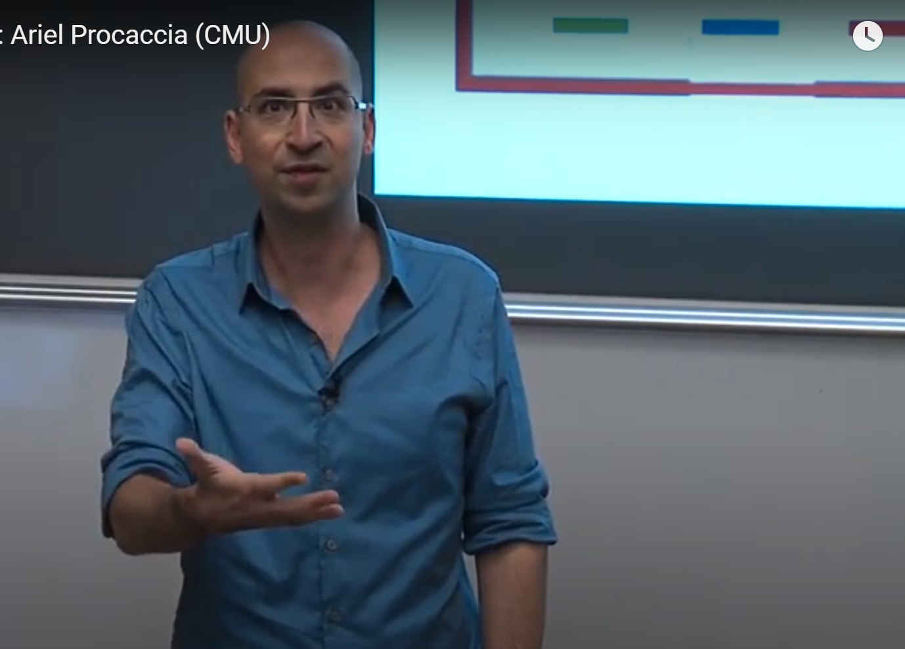
design (Others).

Slide 61
design.
Animations: Can be helpful, don’t go overboard.
A full page at once can be daunting.
Hard for audience to focus.
Good to break up arrival into connected chunks.
But per-line animation gets annoying.
Especially if there’s any clicker lag.
Forces all audience to go exactly at your speed.

Slide 62
design.
Math: Minimize mathematical notation.
Mechanism $φ$inputs ordinal preferences $≻$ and outputs a matching $φ\left(≻\right)$. Let $r_{x}\left(φ\left(≻\right)\right)$ be the rank of the match of agent $x$ under preferences $≻_{x}$.
Definition. Mechanism $φ′$ stochastically dominates mechanism $φ$ for agent $x$ if for all ranks $k$,
$\operatorname{Pr}\left[r_{x}\left(φ′\left(≻\right)(x)\right)≤k\right]≥Pr⁡[r_{x}\left(φ\left(≻\right)\left(x\right)\right)≤k]$.

Slide 63
design.
Math: Minimize mathematical notation.
Mechanism $φ$inputs ordinal preferences $≻$ and outputs matching $φ\left(≻\right)$.
Definition. Mechanism $φ′$ stochastically dominates mechanism $φ$ for agent $x$ if for all ranks $k$ and all $≻$,
$\operatorname{Pr}\left[x gets top k in φ^{′}(≻)\right]≥Pr⁡[x gets top k in φ(≻)]$.

Slide 64
design.
Use images when appropriate. Example:
Construction: S$←$ random set of size m/2.
$T←$ random set of size m/2, conditioned on $|S∩T|=m/3$.
Alice gets one special set $A_{0}$. Bob gets $B_{0}$.
$\left|A_{0}\right|=\left|B_{0}\right|=m/2$.
$\left|A_{0}∩S\right|=\left|B_{0}∩T\right|=m/3$.
Case 1: $A_{0}∩B_{0}=∅$. Case 2: $A_{0}=B_{0}$.
$m$ items
$$S$$
$$T$$
Case 1 $A_{0}$
Case 1 $B_{0}$
Case 2 $A_{0},B_{0}$
Notes:
A picture is worth 1000 words.
Shapes help color-blind people distinguish elements
Consistency
Alignment

Slide 65
speaking.
Entertain your audience!

Slide 66
speaking.
Working the crowd: Your job is to please the audience!
Always better to under-estimate your audience.
Ask and answer questions, when appropriate.
Adapt to what the audience wants to hear.
Voice: Be confident!
Speak up, slow down/pause, and use intonation.
Trick: take a breath after each slide.
Have a concrete plan for important talking points.
Timing: NEVER EVER go over your allotted time!
Plan what to skip if you are running short on time.
Notes:
A talk is an advertisement
Take questions offline if it’s getting annoying for others

Slide 67
summary.
Important elements.
Identify three main take-aways (at most).
Keep it simple (design and content).
Entertain your audience.

Slide 68
Website Principles
Why should you make a website?
Visibility is important! Say you give a good talk/poster presentation and Daniela notices. She wants to learn what year you are, who your adviser is, or check out your other work. Make it feasible!
Good to match norms. In CS, most senior PhD students have websites. If you don’t have one, others might think you’re disorganized.

Slide 69
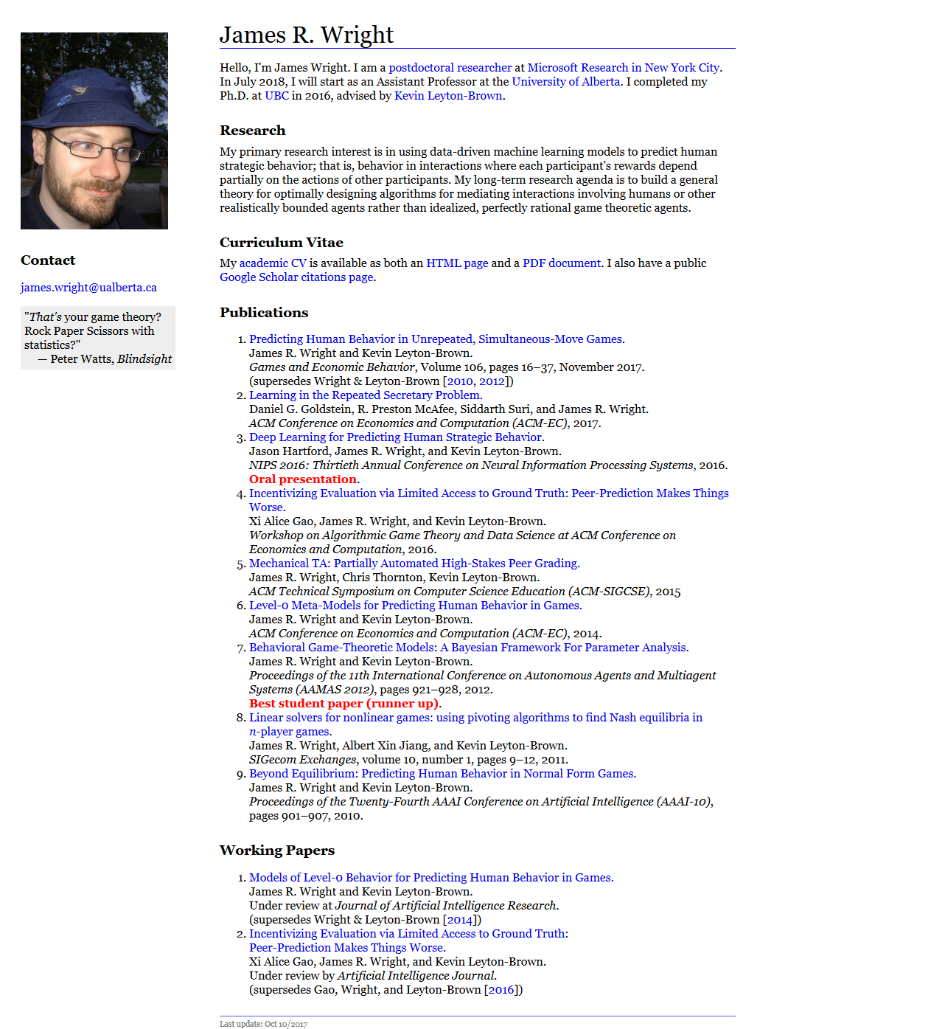
2. Bio/Affiliation
1. Picture
3. Contact
4. Research/Publications

Slide 70
Website Principles
Purpose: introduce yourself. Use this to guide design.
Example: What if I don’t have any publications yet?
OK to omit. OK to put “coming soon!”
People still want to know you without publications.
Example: Should I list unfinished manuscripts?
One reason: excited about not-yet-published work.
One reason: make research activity look larger.
Still: please don’t mislead readers.

Slide 71
Website Principles
Purpose: introduce yourself. Use this to guide design.
Example: Should I include personal information?
Depends on what you want others to see!
Example: What if I’m bad at HTML?
OK to copy a friend’s source code (but ask them to avoid awkwardness…).
OK to use generic (but clean) free layouts.
People still want to know you if you’re bad at HTML!

Slide 72
Website Principles
Purpose: introduce yourself. Use this to guide design.
Example: Should I list awards?
Sure! If you want others to know about them.
Last suggestion: Be transparent.
It’s OK to brag a bit.
OK to list unpublished work to appear more active.
Just use same social norms: don’t be coy about it.

Slide 73
Networking Principles
Context: researchers love meeting new students.
But also super busy. Just be respectful of time.
Any reason is a good reason to start a conversation.
Sample starters:
I liked your talk. Can I ask you for more details re: X?
I’m working in (your area), and wondering if you’re aware of any prior work which does XYZ?
If you happen to be sitting together at lunch, or another social event, OK to just say hi.

Slide 74
Networking Principles
Context: researchers love meeting new students.
But also super busy. Just be respectful of time.
Any reason is a good reason to start a conversation.
Best Case: they want to hear about you. Be ready!
Good to have an outline answer prepared for:
“Tell me about one of your favorite projects.”
“What’s your research area?”

Slide 75
Appendix: How to Parse Feedback
Context: you’ll constantly get feedback forever.
Some feedback is amazing and easy to parse.
“I think you should do XYZ because ABC.”
And you completely agree immediately.
Most feedback is not. Especially when it’s non-interactive from reviewers, course evals, etc.
“The paper is OK I guess.”
But you can still get something out of it!

Slide 76
feedback examples.
Theme of advice: Why did this person give this feedback.
“I can’t follow the proof of Theorem 1, why does Ax = b?”
If you clearly stated why Ax = b, OK to complain! (I do).
But don’t only complain. Make it clearer.
“The results are fine, but incremental compared to [ABC].”
If [ABC] is completely different, OK to complain! (I do).
But adjust your next draft to better distinguish.
Notes:
A talk is an advertisement
Take questions offline if it’s getting annoying for others

Slide 77
personal anecdote.
Senior prof offered to skim my job talk.
Was ~50 minutes on my thesis work.
Pretty blunt appraisal (paraphrased): “So my opinion on this stuff is that there were these open problems and you solved them. But it’s not really that relevant or exciting and it’s not clear what’s next.”
That hurt a lot, but it turned into great advice: others thought this way too, I really needed to address this.
Point: I disagree with the subjective evaluation, but the advice was needed. Radically improved my talk.
Notes:
A talk is an advertisement
Take questions offline if it’s getting annoying for others

Slide 78
Themes and Disclaimers.
Disclaimer: Most of the advice given in this talk is subjective: mix of advice from Nicole and Matt.
Recurring Theme: Always understand why.
Do look to others for examples of good talks/websites/papers/etc.
Don’t try to “follow the rules” without understanding why.

